Slide 1

Allahdad
023-22-0056
Climate change in Pakistan

Slide 2
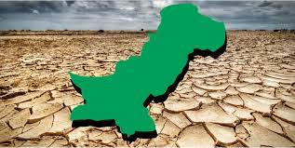
Climate Change in Pakistan

Slide 3
Climate Change
Climate change is the long-term heating of Earth's surface observed since the pre-industrial period (between 1800 and 1900) due to human activities, primarily fossil fuel burning, which increases heat-trapping greenhouse gas levels in Earth's atmosphere.

Slide 4
Causes of Climate Change in Pakistan
Deforestation
Generating of Power
Manufacturing of goods
Using Transportation
Green House Gases
Over population

Slide 5
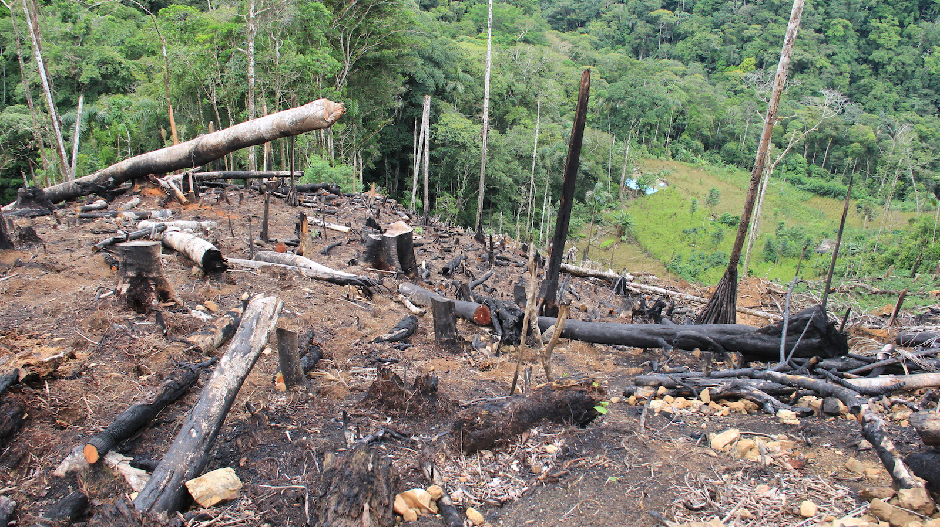
DEFORESTATION
THE ACTION OF CLEARING A WIDE AREA OF TREES.

Slide 6
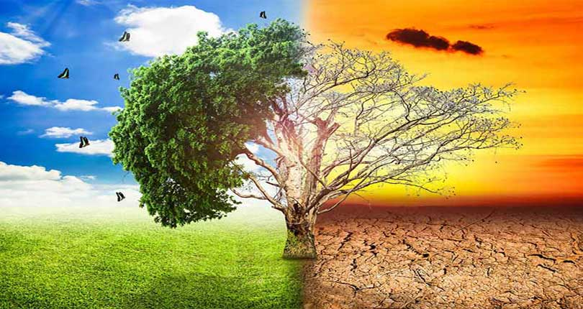
Change in Climate

Slide 7
Generating of Power
It is a process to generate electricity power from sources of primary energy.
1.Generating from Natural Gas
2.Generating from Coal
3.Generating from Water

Slide 8
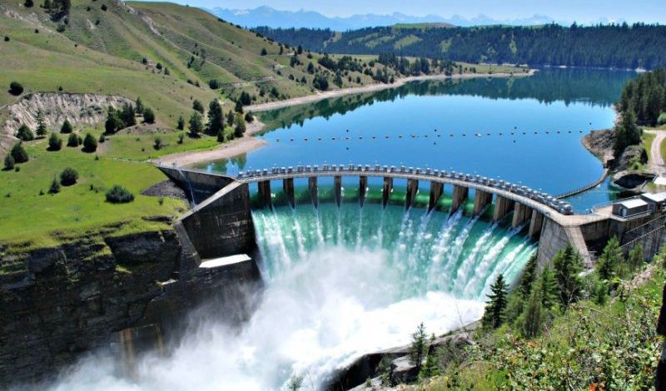
Generating of Power
From Water

Slide 9
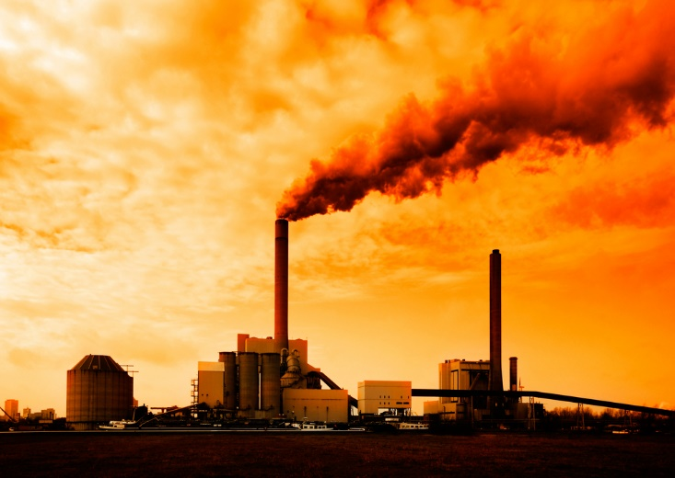
Fossil Fuel From Thermal Power Plant

Slide 10
Manufacturing of goods
is the process of making of goods by hand or by machine that upon completion the business sells to a customer.

Slide 11
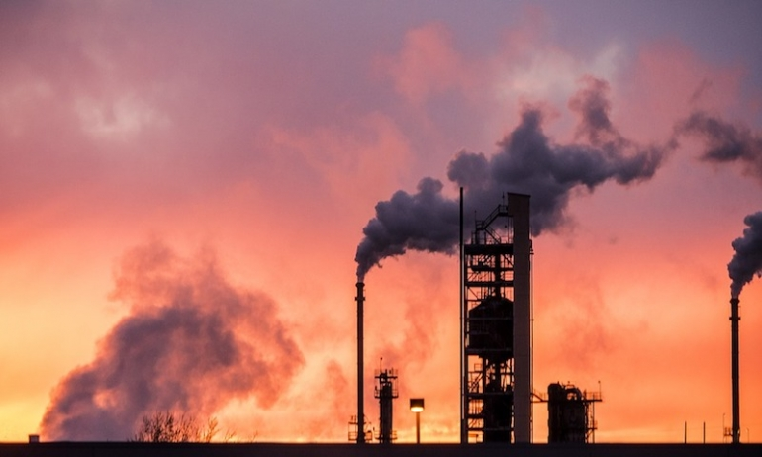
Fuel of Factory of Manufacturing goods

Slide 12
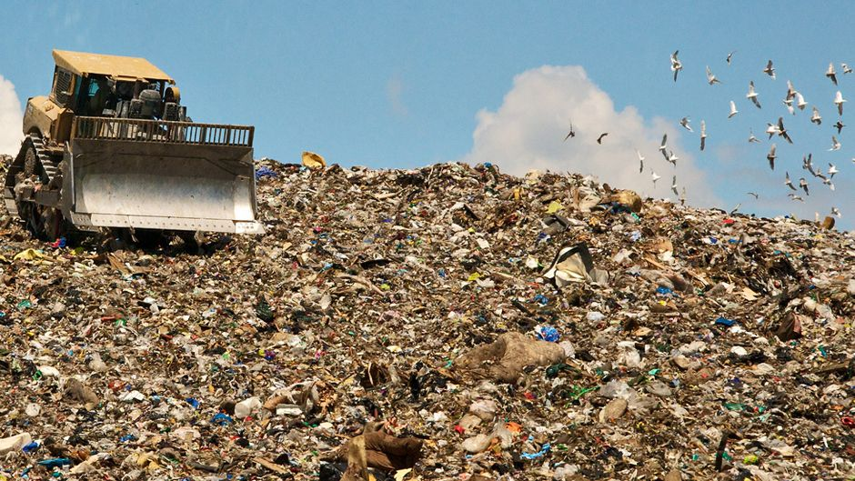
Garbage of that goods

Slide 13
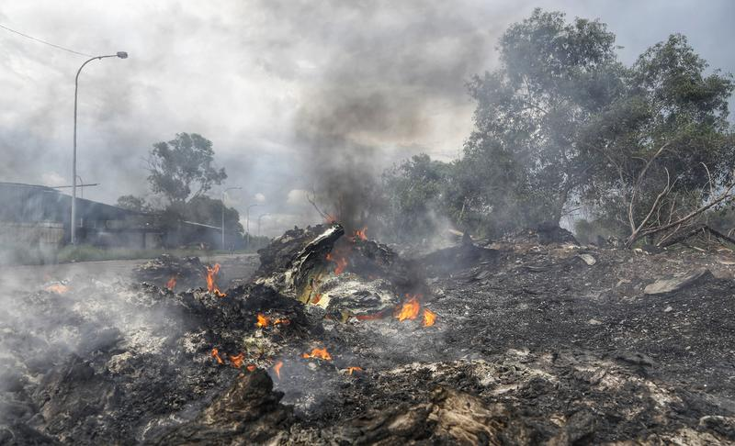
Burning of that Garbage

Slide 14
Using Transportation
Over Traffic is also the biggest cause of global warming. The vehicles
that consume oil and produce heat and noise , spoil the environment.

Slide 15
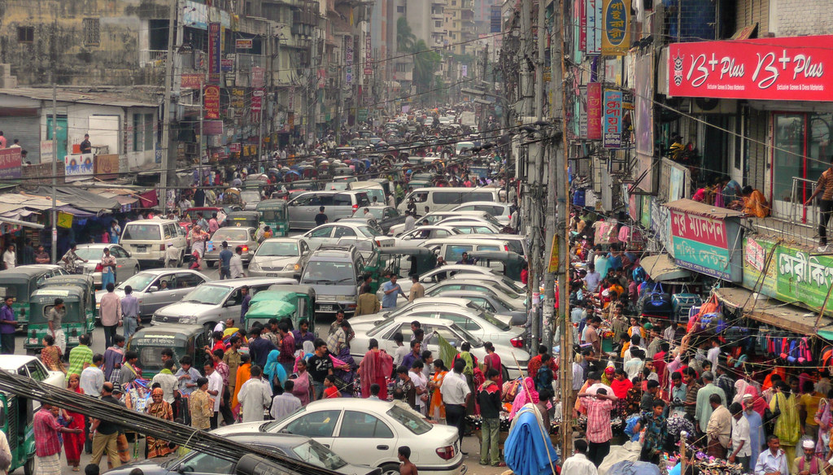
Over Traffic in Pakistan

Slide 16
Green House gases
The main gas responsible for the green house effect includes carbon dioxide, methane, nitrous oxide, and water vapor.

Slide 17
Green House Gases
carbon dioxide
methane
nitrous oxide
water vapor

Slide 18
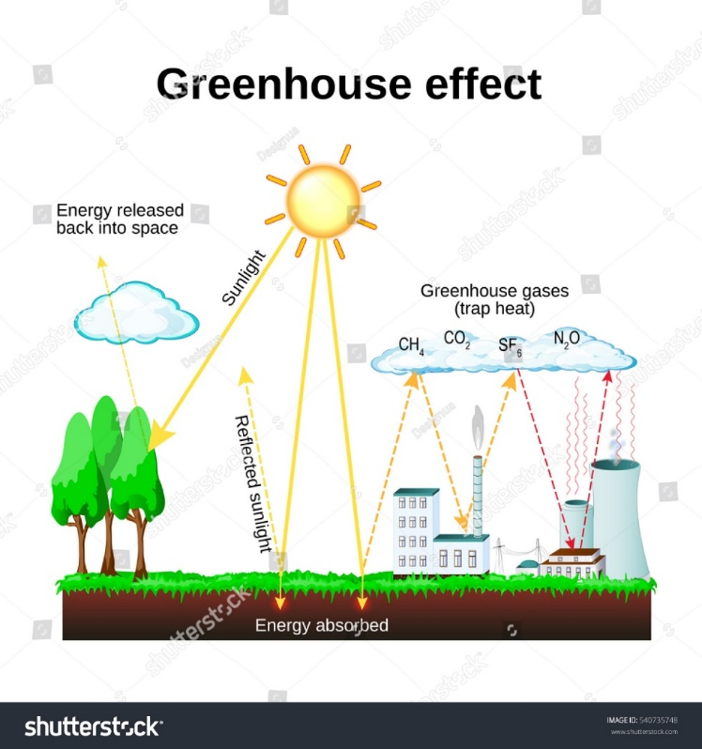
Green House gases

Slide 19
Effects of Climate Change in Pakistan
leads to an increase in flood risk
Unseasonable rains
Melting of glaciers
Food Crises
Economic loss
Infrastructure

Slide 20
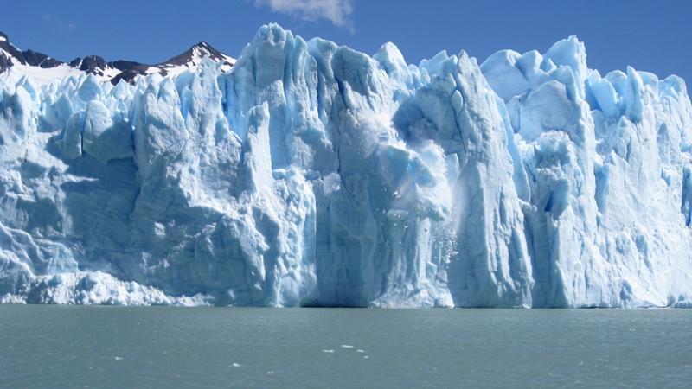
Melting of Ice Glaciers and cause of flood

Slide 21
Unseasonable rains in Pakistan
The highest rainfall of 620 millimeters (24 in) was recorded in Islamabad.
Recently Monsoon was recorded in all over Sindh and even Pakistan.

Slide 22
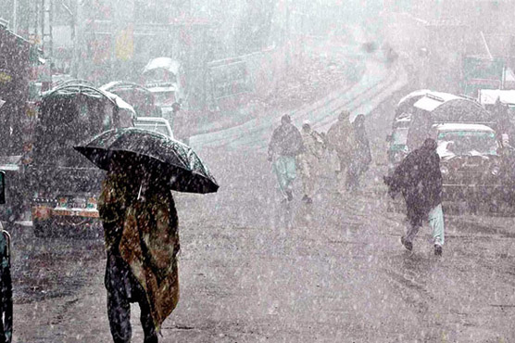
Heavy rainfalls

Slide 23
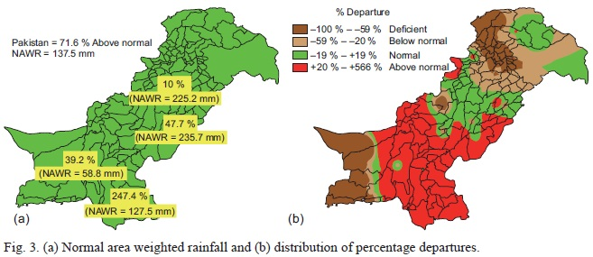

Slide 24
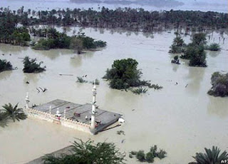
Flood of 2010

Slide 25
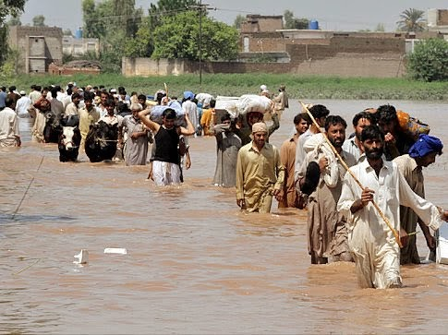
Flood of 2010

Slide 26
Damage of Pakistan in 2010 flood
killing more than 1,700 persons,
affecting over 20 percent of the land area,
more than 20 million people was effected
and causing loss of billions of dollars through damages to infrastructure, housing, agriculture and livestock, and other family assets.

Slide 27
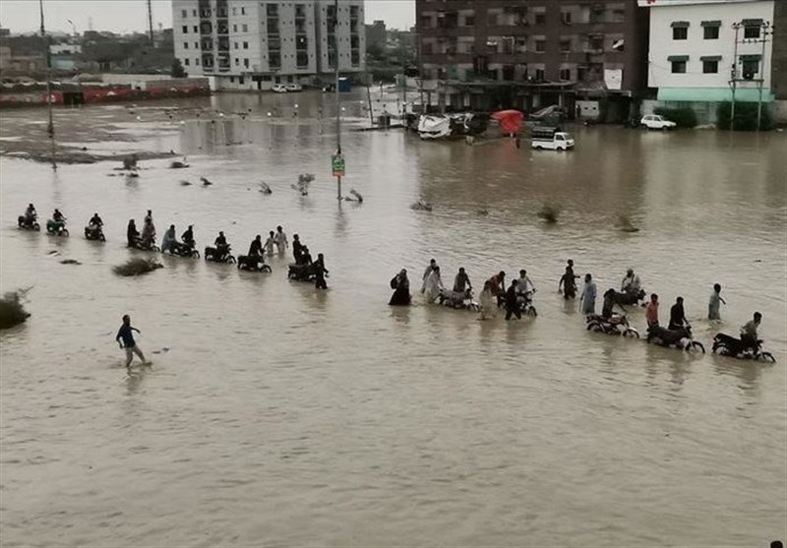
Flood of 2022 in Pakistan
Same as 2010 as in 2022

Slide 28
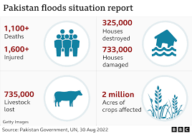
Loss of Pakistan due to flood in 2022

Slide 29

Pakistan suffered climate-induced losses worth $29bn:WORLD BANK

Slide 30
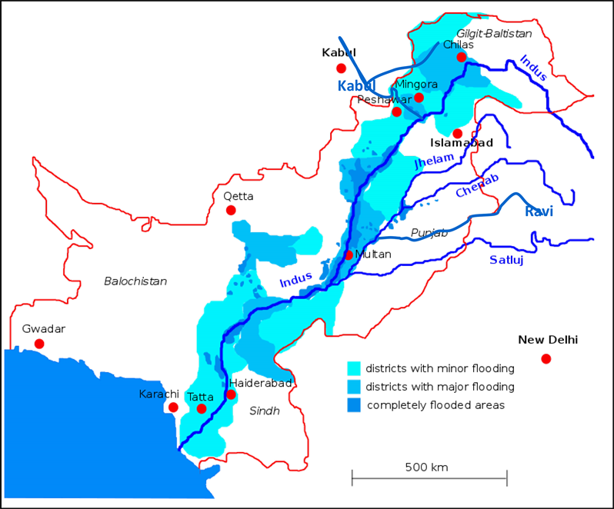
Districts effected Most

Slide 31
Between 1998 and 2018 Pakistan reported more than 150 extreme weather events. In 2022 disastrous floods hit the country. The main causes were increased precipitation and glaciers melting fueled by climate change. One third of the country was under water in 2022.

Slide 32
The floods affected 33 million people in Pakistan and destroyed 897,014 houses and damaged another 1,391,467. 1,164,270 livestock have been killed, most of them in the province of Balochistan, while destruction to 13,115 kilometres (8,149 mi) of roads and 439 bridges has impeded access across flood-affected areas.

Slide 33
Diseases due to flood of 2022
Wound infections
Skin rash
Malaria
Typhoid

Slide 34
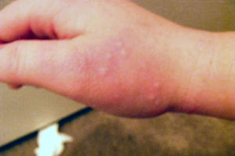
Skin Trash

Slide 35

Wound Infections

Slide 36
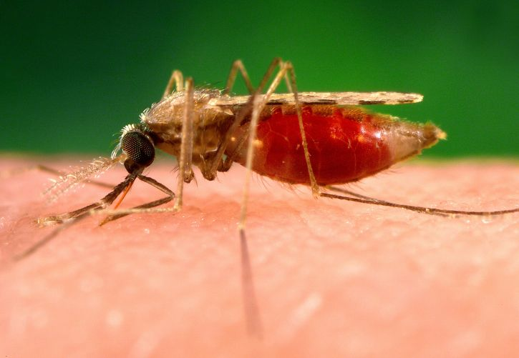
Malaria

Slide 37
Record of cities of Pakistan
Jacobabad
Sibi
Nawabshah
Padidan
Turbat
Dalbandin

Slide 38
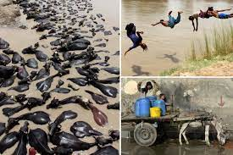
If we go to hell, we'll take a blanket," is a common joke told in the area of Jacobabad.

Slide 39
.Climate change is the more frequent and more intense occurrence of extreme weather events, and this is exactly what we have witnessed in Jacobabad. Said Athar Hussain ( head of the Centre for Climate Research and Development )

Slide 40
Solutions of climate change in Pakistan
Plant a tree
Avoid throwing garbage on the roads and rivers
Use more electric vehicles
Avoid Deforestation
Avoid Over Traffic
Reduce the use of Plastic goods
Use more Solar system instead of electricity

Slide 41
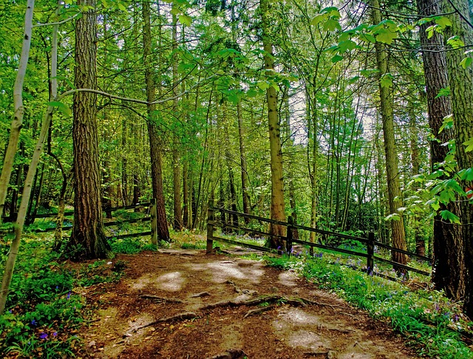
Pakistan is getting rid of climate change

Slide 42


Slide 43
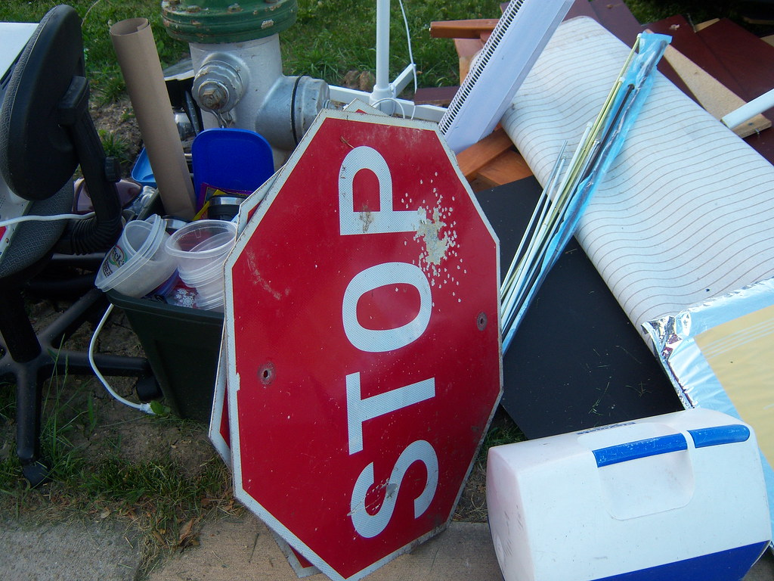
Stop trashing Garbage

Slide 44
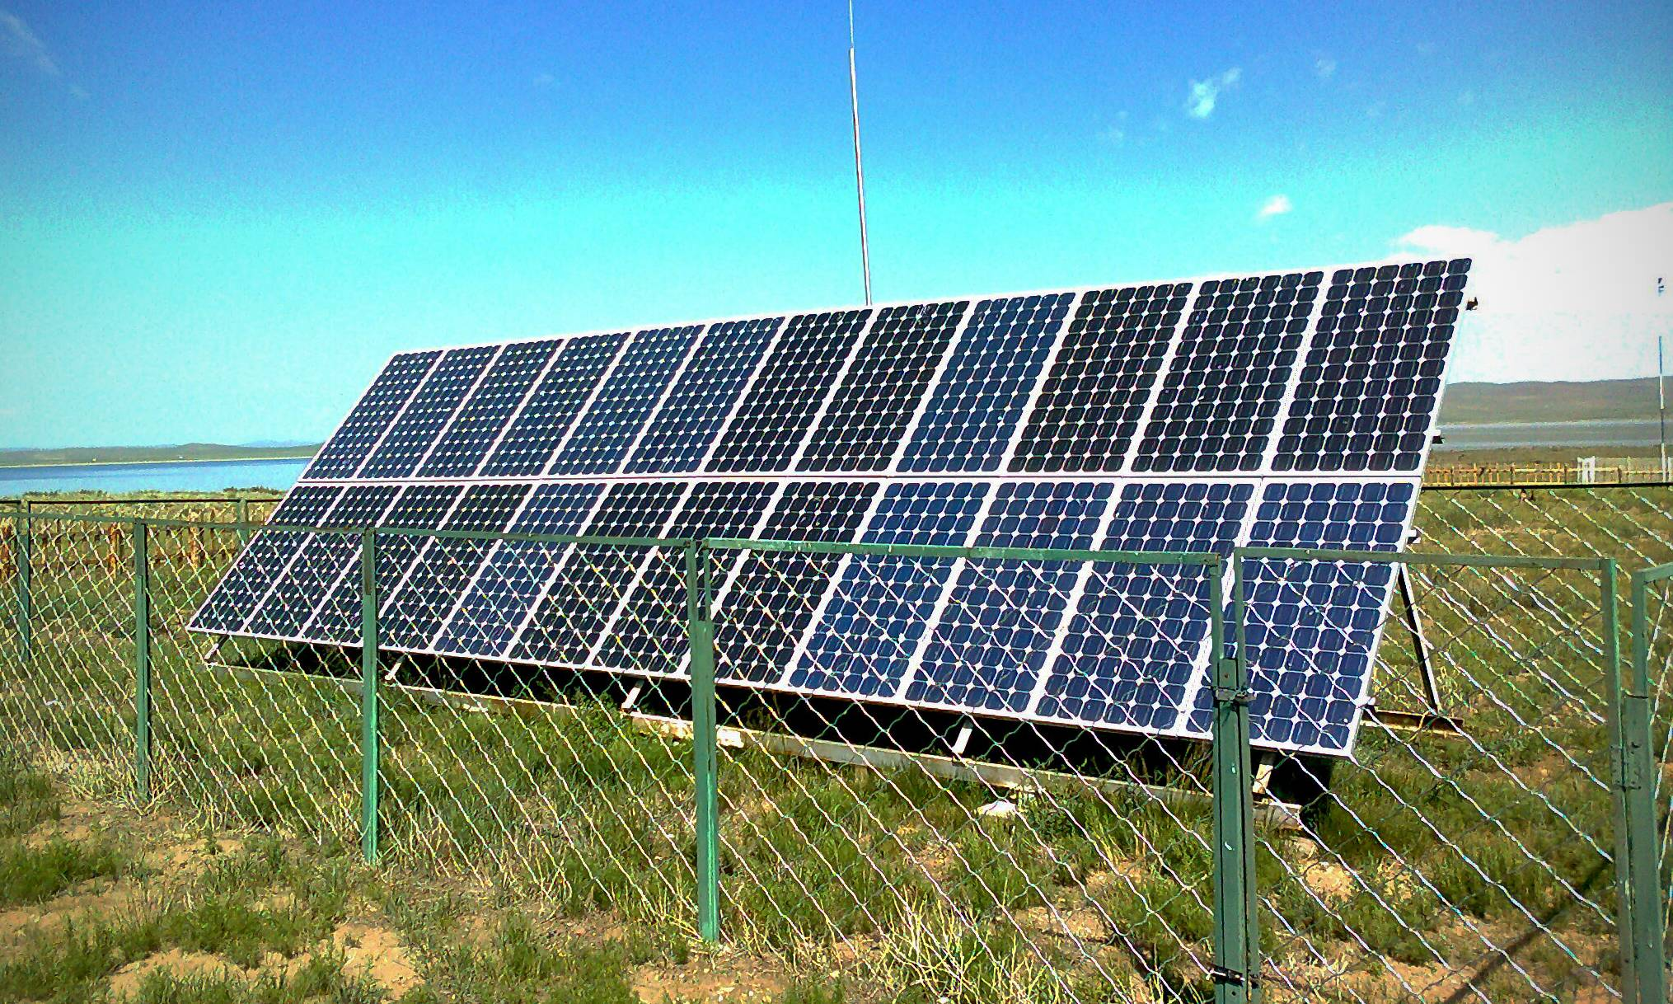
Use more Solar system instead of electricity

Slide 45



